Slide 1
Topic: Finance EQ: What is Compound Interest?
Year 10 Mathematics

Slide 2
Interesting Interest
Interest is money added on top of an existing amount.
Interest accrues over time – usually year long periods, but can be daily, weekly, fortnightly
Simple interest is a fixed amount of money earned off an amount. The formula for simple interest is – I=P x R x T,
P is principle amount – the dollars you begin with
R is the rate – this is a decimal ( % / 100)
T is the time in years
Eg find the Simple interest on $15000 at 7.5%pa for 5 years I = P x P x T = 15000 x 0.075 x 5 = $5625 Total is = 15000 + 5625 = $20625

Slide 3
Topic: Finance EQ: What is Compound Interest?
Compound interest is when you earn interest each time, based upon on previous amount.
If we look at the same problem from before, but apply compound interest we see it grow a lot quicker-
Initial Amount | Simple interest PxRxT | New amount
15000 | 15000x0.075x1 | 16125
16125 | 16125x0.075x1 | 17334.38
17334.38 | 17334.38x0.075x1 | 18634.45
18634.45 | 18634.45x0.075x1 | 20032.04
20032.04 | 20032.04x0.075x1 | 21534.44
From the SI, we earned only $5625, but compounded we earn $6534.44, a difference of $909.44

Slide 4
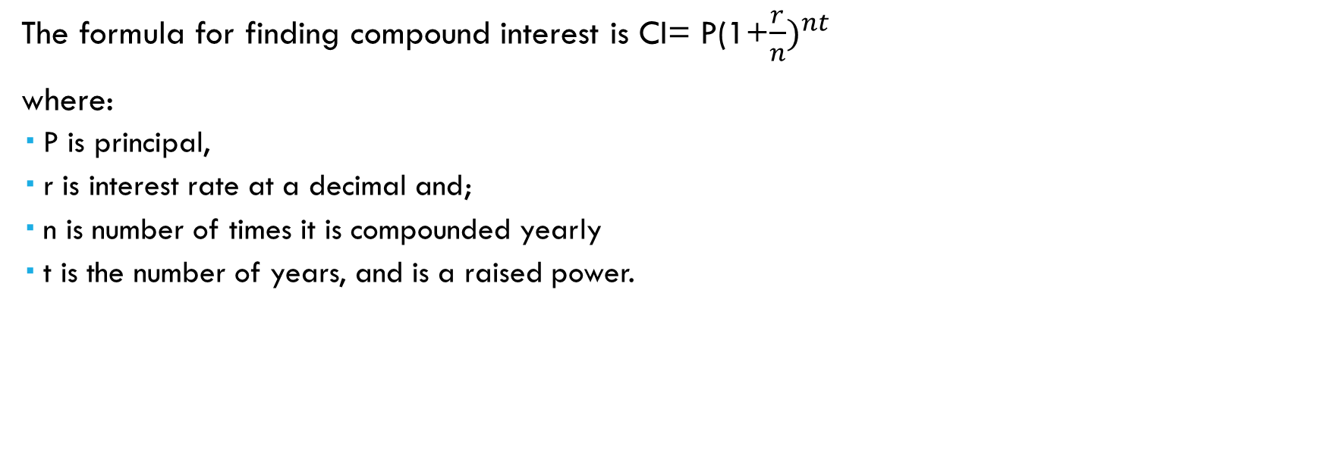
How do we quickly do compound interest?
The formula for finding compound interest is CI= P(1+$\frac{r}{n})^{nt}$
where:
P is principal,
r is interest rate at a decimal and;
n is number of times it is compounded yearly
t is the number of years, and is a raised power.

Slide 5
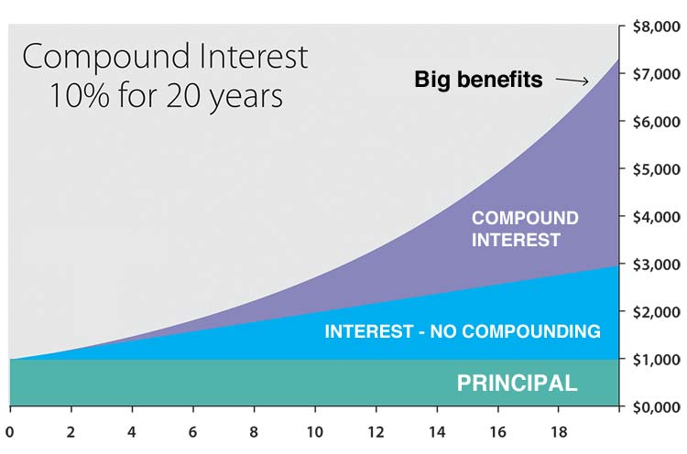
From the graph to right, we can see the difference between the principal over 20 years, simple interest of 10% and compound interest over 20 years. There is an almost a $4,500 difference.
From this graph, we can see that more time makes a bigger difference in the two rates.

Slide 6
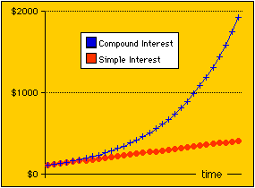
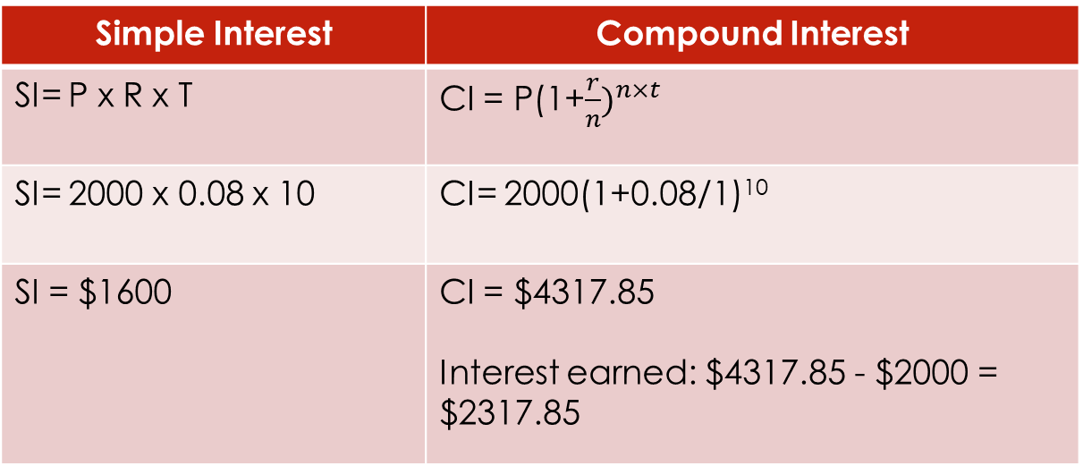
Practice the problem
Dave puts $2,000 in his account at 8% for 10 years.
Compare compound to simple interest and see the difference between the two.
Simple Interest | Compound Interest
SI= P x R x T | CI = P(1+$\frac{r}{n})^{n×t}$
SI= 2000 x 0.08 x 10 | CI= 2000(1+0.08/1)¹⁰
SI = $1600 | CI = $4317.85 Interest earned: $4317.85 - $2000 = $2317.85
Compound interest earns him $717.85 dollars more than simple interest.

Slide 7
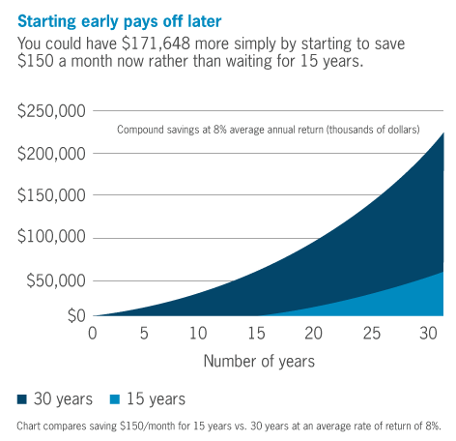
Practical advice
If you get in the habit of putting $75 away each fortnight, you can have ~$220,000 in 30 years. This is because bank accounts use compound interest with their bank accounts.
The same is true for your super. If you contribute and extra $150 a fortnight, the benefits stack up across your working life.

Slide 8
Practise
Find the amount of simple and compound interest for both of the following amounts.
$10,000 at 5% for 5 years
$1,250 at 8% for 20 years
$450,000 at 4.5% for 40 years
Find the gross amount for both simple and compound interest.

Slide 9
Answers
INTEREST AMOUNTS
 | Simple Interest | Compound Interest Gross
A | $2500 | $12,762.82
B | $2000 | $5,826.20
C | $810,000 | $2,617,364.04
GROSS AMOUNTS
 | Simple Interest Gross | Compound Interest Gross
A | $12500 | $ 12 762.82
B | $3250 | $ 5826.20
C | $1,260,000 | $ 2 617 364.04

Slide 10
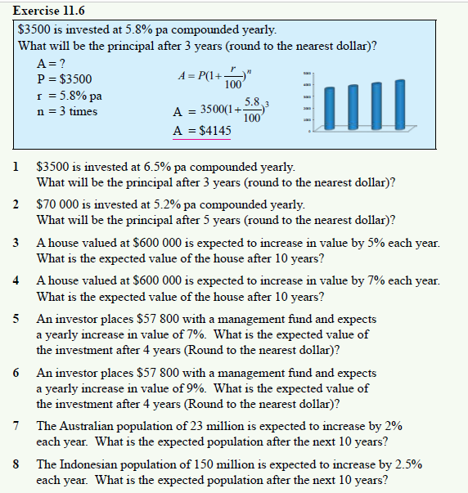
Dywer Year 10 Text Exercise 11.6 Page 319

